Slide 1
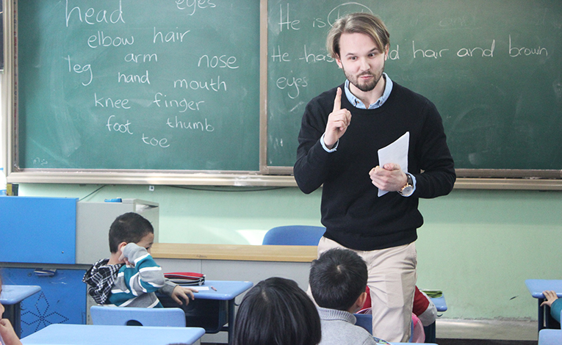





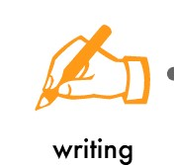

English & ICT
Grade 6 – 11
Let’s get started.
On Going…
English & Tamil Mediums
All theory.
Past papers & model papers discussion.
Tips to score marks in writing.
Explanation in English and Tamil for better understanding.
Individual helps.
Different activities to improve language.
Term Test Papers discussion.
Hemmathagama, Palliporuwa….
071 0344549
S. Kalaiselvan.
4 yrs experienced trainer in teaching.
*Conditions Apply

